Slide 1


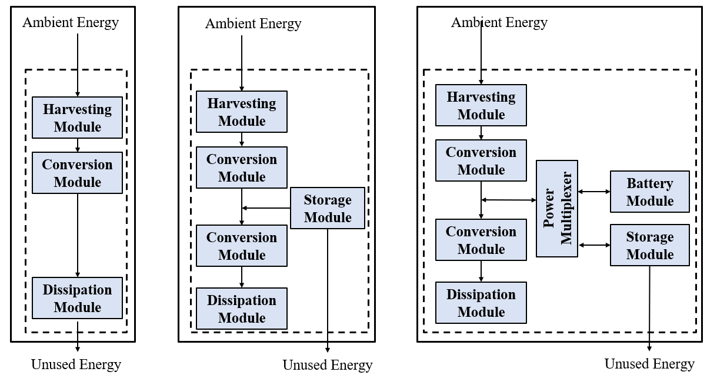
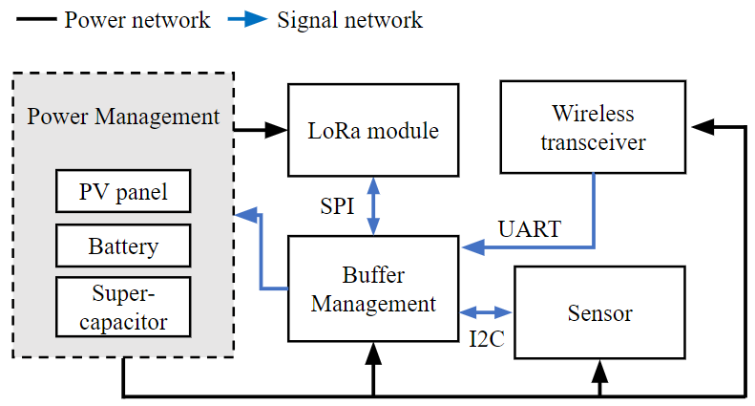
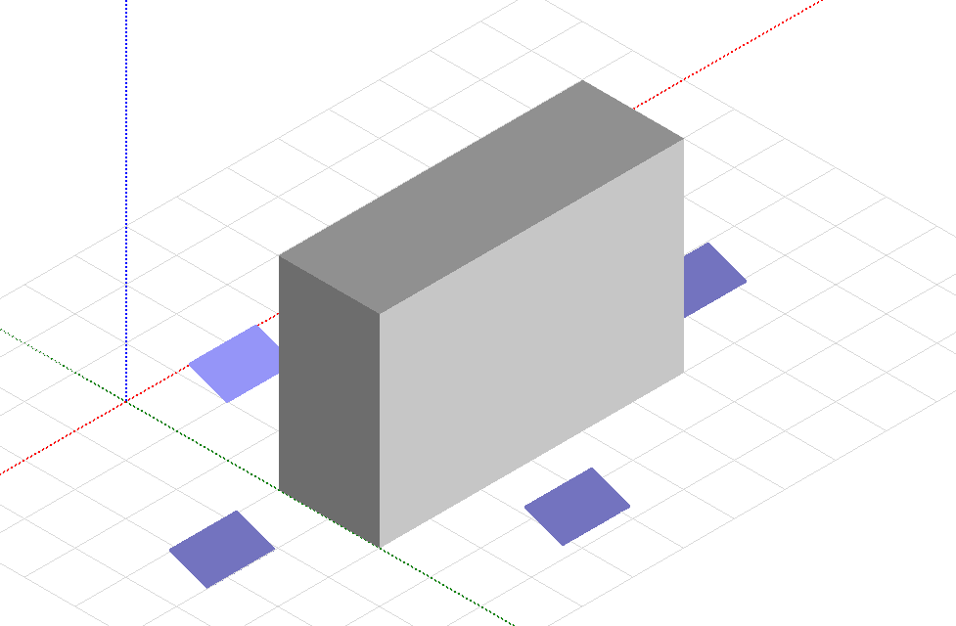
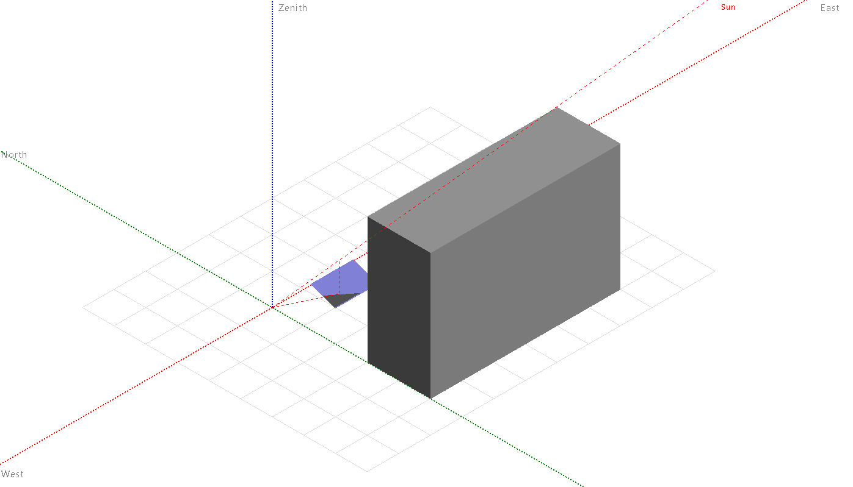
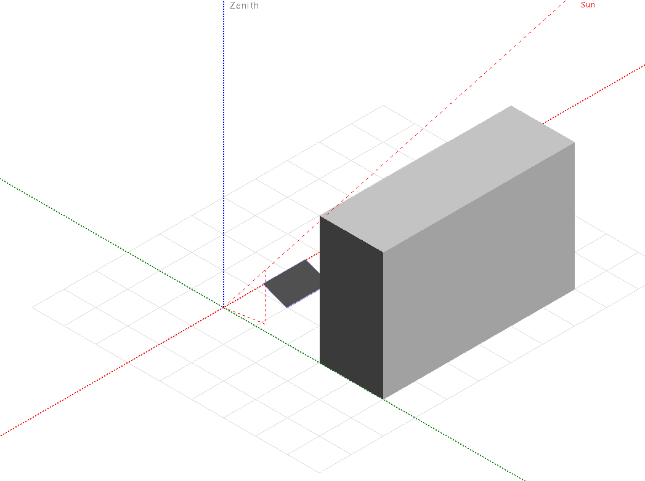
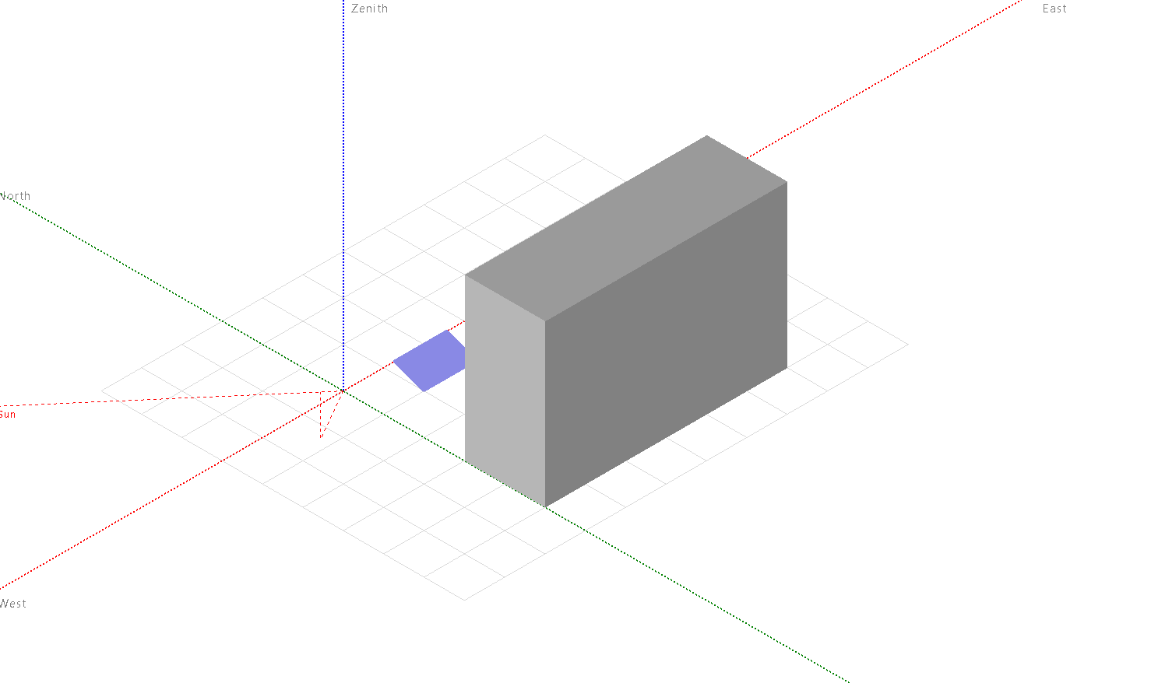
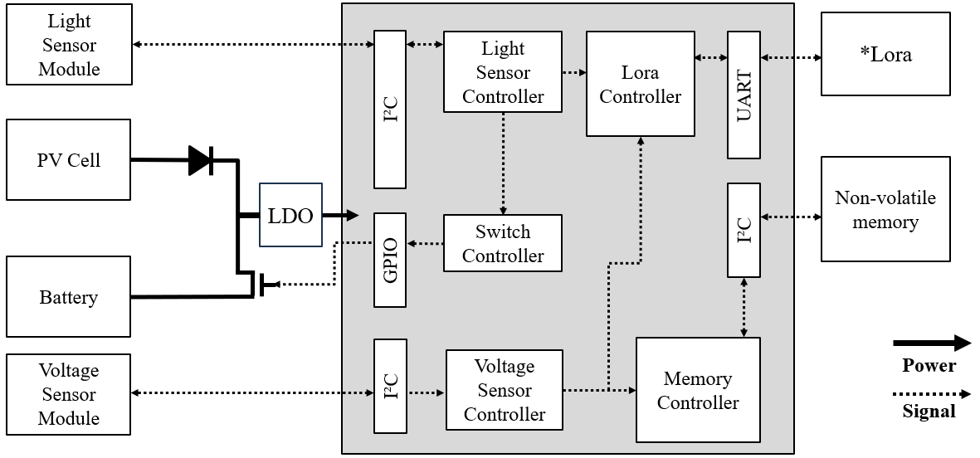
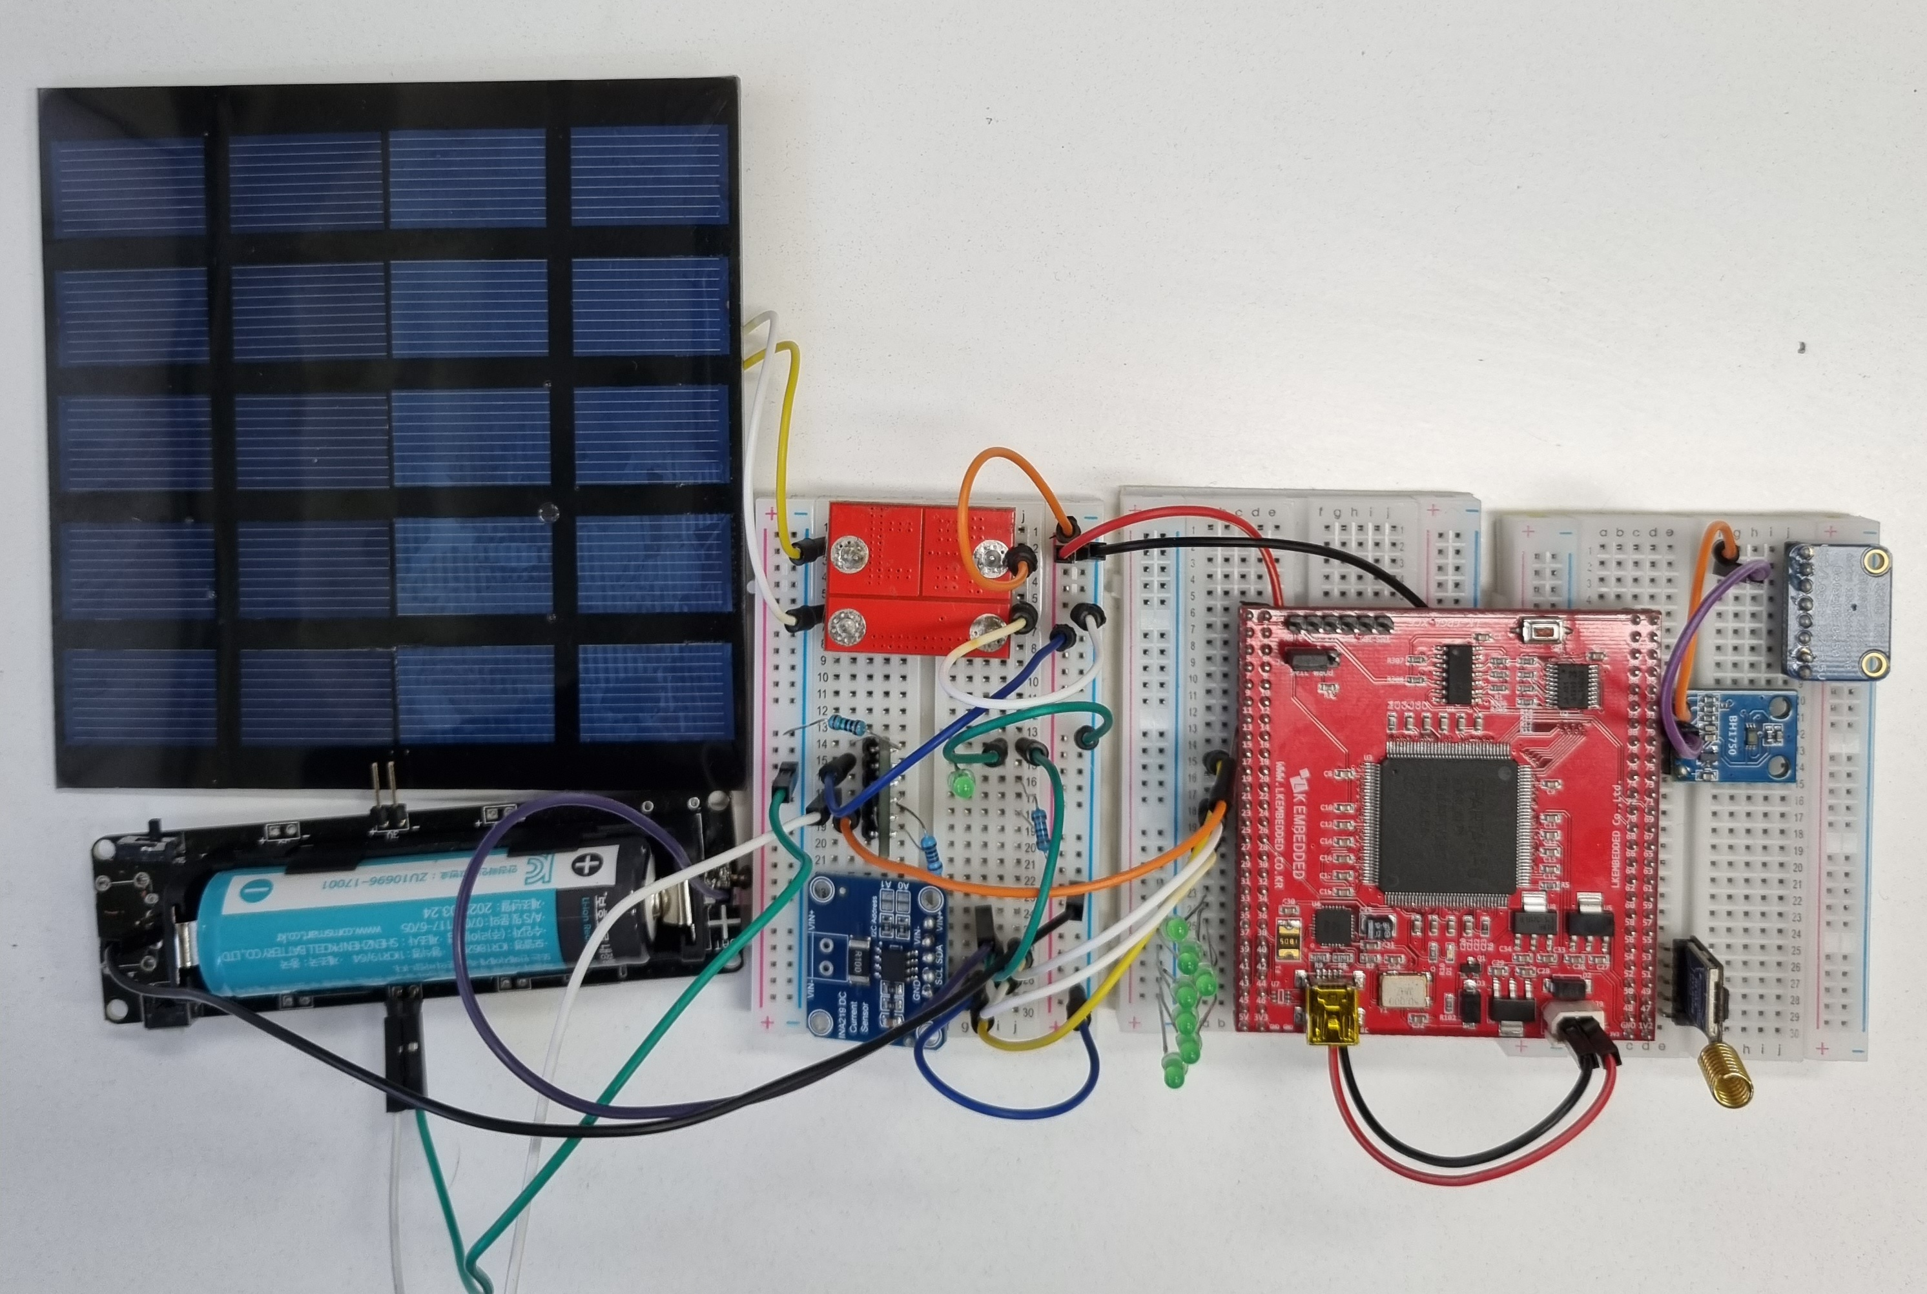
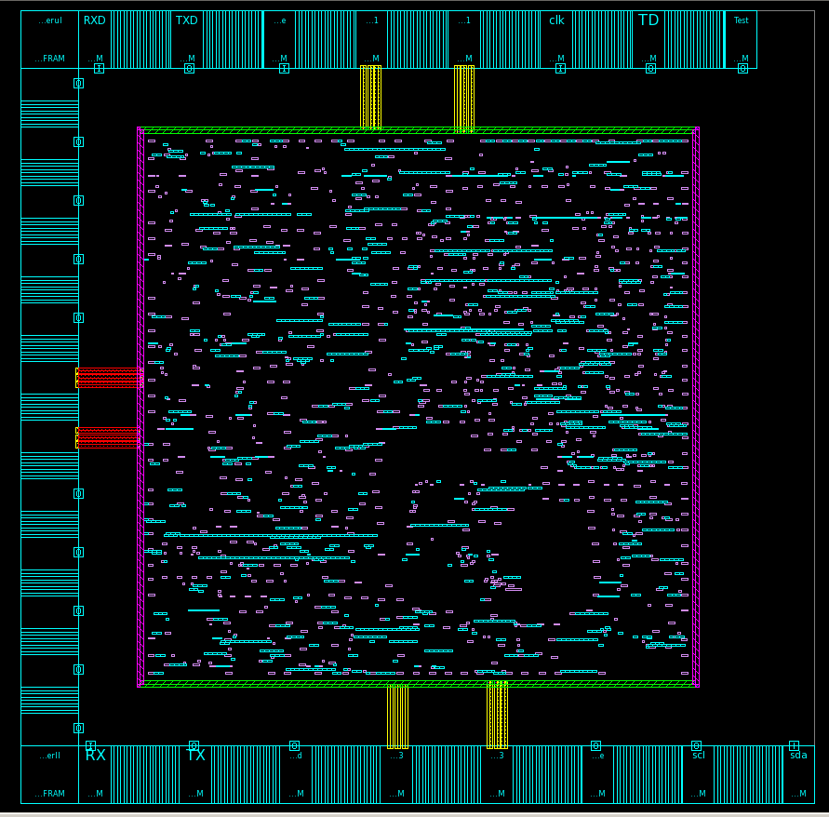
Edge Node Operation Policy using Energy Harvesting to Increase System Lifetime
Yongsu Park, Wootaek Song, Donkyu Baek
Chungbuk National University, Cheongju
Motivation
Methology
Position 1
Position 4
Light quantity
Position 2
Position 3
Switch
MCU
Sun
Sun
Sun
Battery consumption
Use batteries to operate even when there is no harvesting energy charge and supply to capacitor
Limiting the communication cycle by charging the capacitor
Power Scheduling X
Solving the above problems
09:00
13:00
15:30
Operate efficiently based on the collected data
Scheduling with Light Volume
Battery switch control based on threshold
Shades of buildings affect over time
Place 4 nodes in different locations
Implementation
Light Sensor
&
Switch
Controller
Voltage Sensor
Controller
PV Cell
Diode
NVM
Power
Switch
Controller
Light
Sensor
Li Battery
Voltage
Sensor
Lora
Lora Controller
Memory Controller
SoC (System on chip) design using HDL
Adjust workloads according to light volume
Manage workloads according to the state of charge
Backing up memory before the battery runs out
Measurement results
Conclusion
Position 4
Position 3
Position 2
Position 1
Workload Ratio
Before
After
Power Distribution by Location over time
Battery Consumption Rate
74.71
87.78
89.35
92.88
88.62
89.2
Workload Ratio
73.21
90.55
89.21
Position 4
Position 3
Position 2
Position 1
24.99%
78.81
90.4
89.46
30.12%
Does not Consider Light Level Consider Light Level Consider Light Level and SoC
22.43%
22.43%
15.5
Reduce operational limitations while increasing node life using batteries and energy harvesting in edge computing environments
However, depending on the environment, power variations occur between edge nodes, which reduce the lifetime of certain nodes, deteriorating the overall performance of the system
The proposed structure and operation method were applied to enable the least-lived nodes to operate with a similar lifetime to the most nodes
No deviations across all nodes to increase system performance
Workload Ratio
Position 4
Position 3
Position 2
Position 1
24.78%
29.72%
5.53
22.64%
22.84%
0.004
Does not Consider Light Level Consider Light Level Consider Light Level and SoC
The chip fabrication was supported by the IC Design Education Center(IDEC), Korea.

